Slide 1
EPA’s Climate Ready Water Utilities: Supporting Utilities Adapting to the Impacts of Climate Change
Steve Fries
U.S. Environmental Protection Agency
Office of Ground Water and Drinking Water

Slide 2
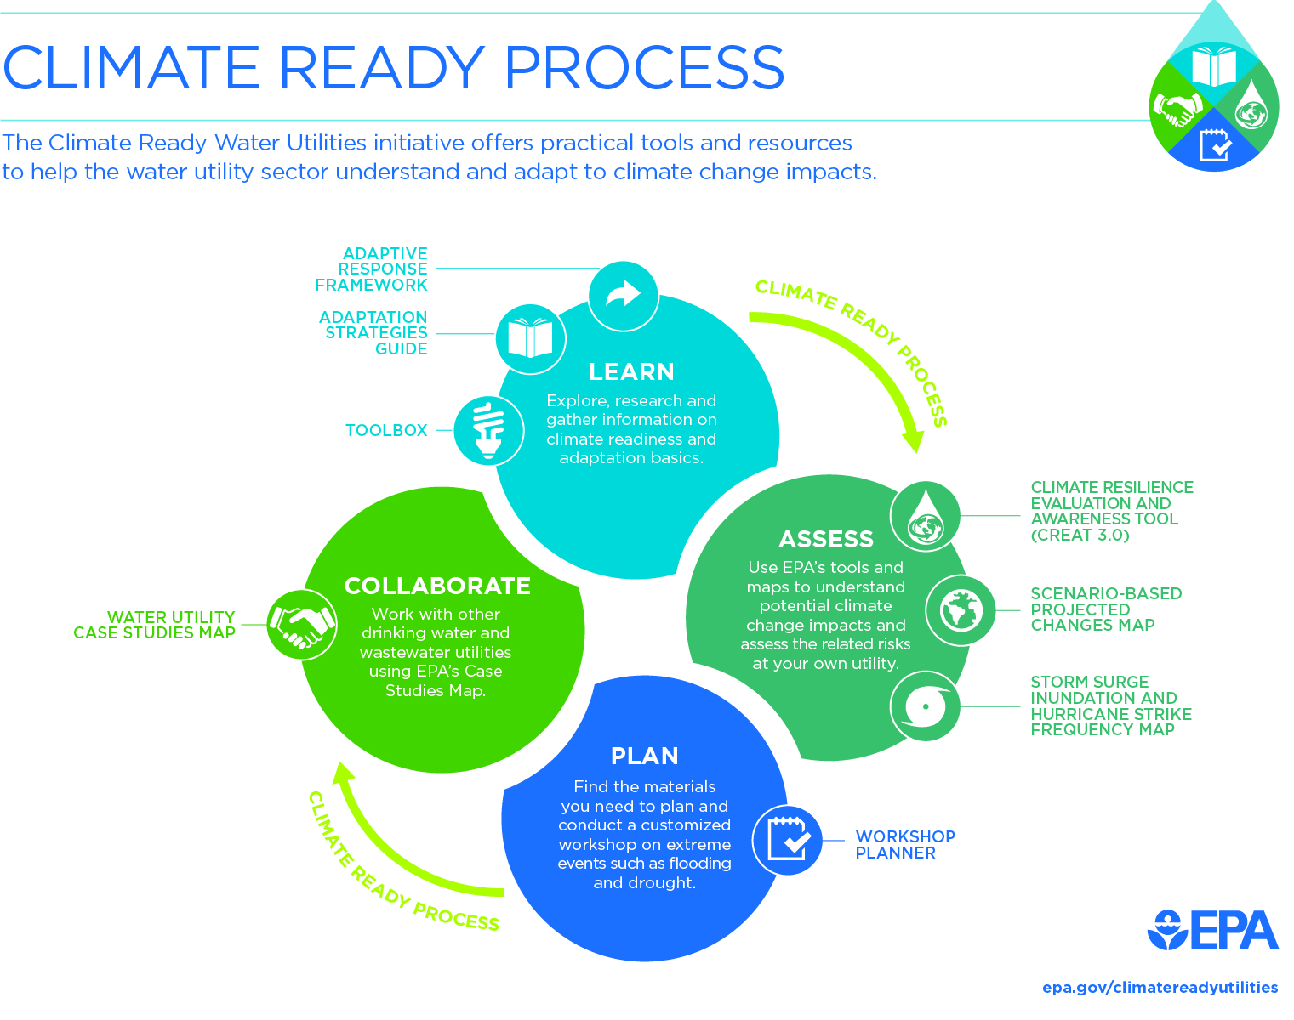
Notes:
2

Slide 3
Web Products for Collaboration Learn from others and exchange information to build effective and coordinated plans to increase resilience

Slide 4
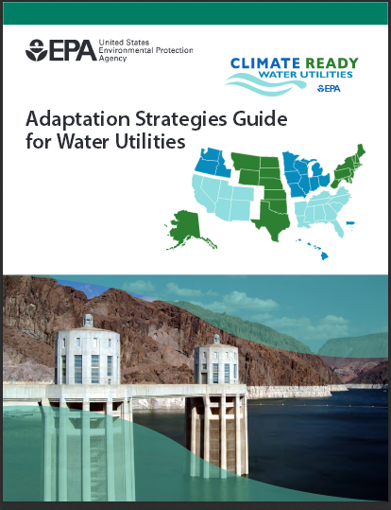
Adaptation Strategies Guide Overview
LINK
Guide for utilities to consider climate change in utility planning
Translations of climate science into impacts and adaptation strategies for utilities
Past updates for sustainability and 2014 National Climate Assessment
PLANNED UPDATE
Web application instead of PDF
Additional utility case studies

Slide 5
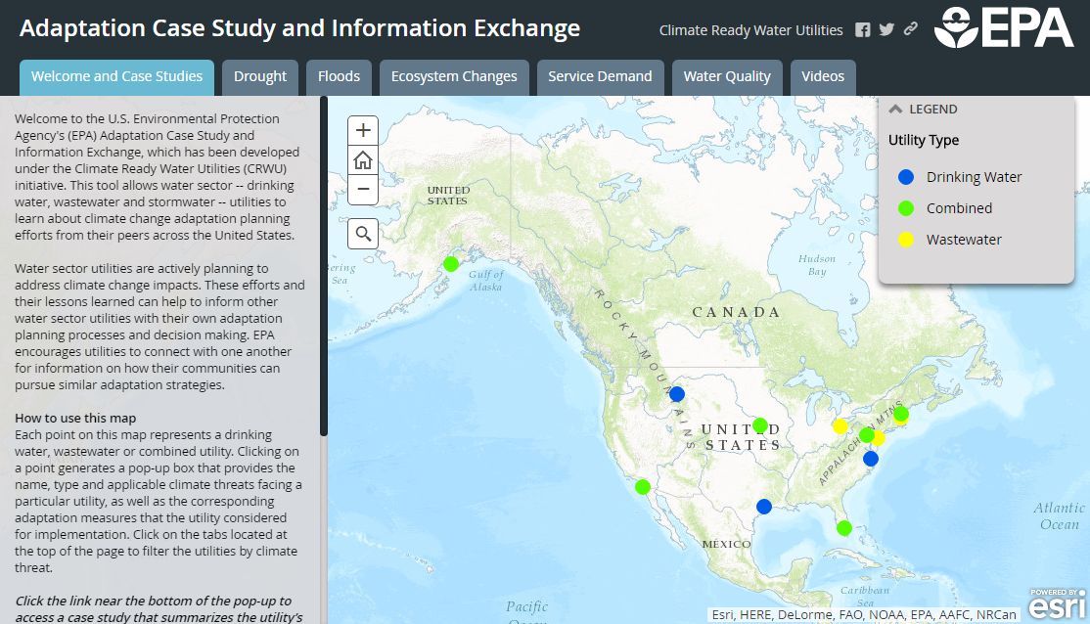
Case Study and Information Exchange
LINK

Slide 6

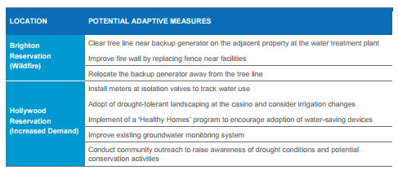
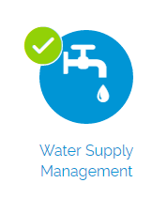
Example Case Studies – Seminole Tribe of Florida
Assessment focused on demand and wildfire after exploration of flooding risk revealed potential impacts lower than other risks
Planning efforts encompass multiple communities with different needs and potential hazards

Slide 7
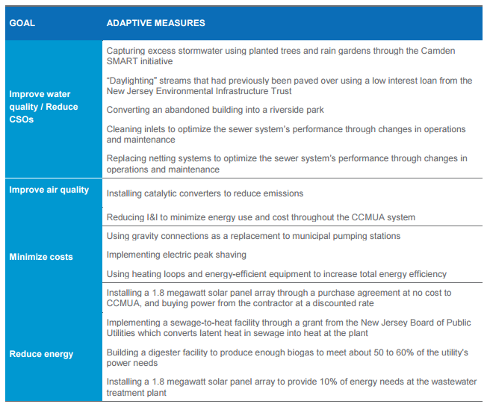
Example Case Studies – Camden County MUA (NJ)
Assessment focused on improving operations under changing climate conditions as well as addressing potential extreme events
Planning efforts encompass multiple goals for optimizing energy use and cost along with gains in resilience

Slide 8
Climate Resilience Evaluation & Awareness Tool (CREAT) Assess Risks and Plan Adaptation for your Utility

Slide 9
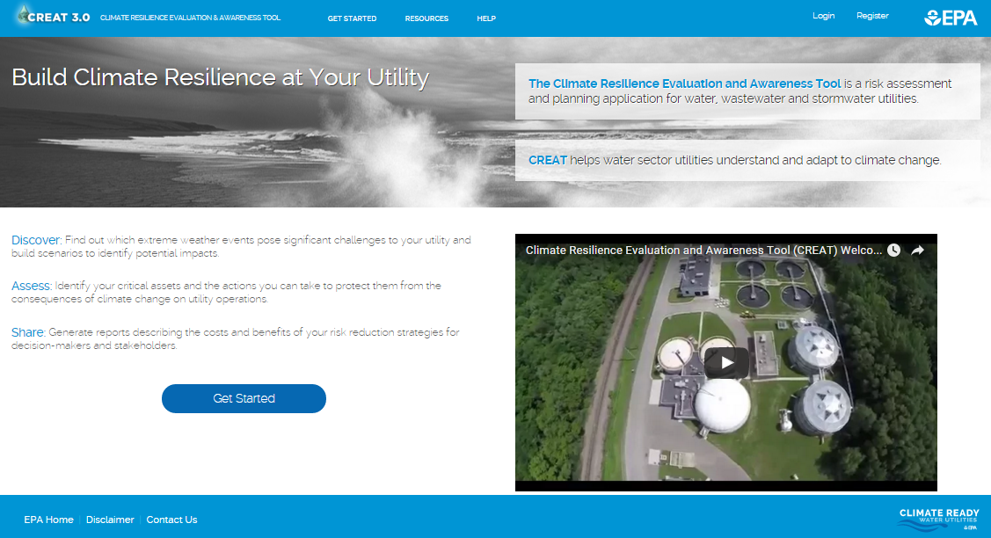
CREAT 3.0
PLAY

Slide 10

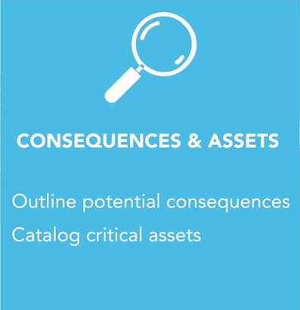
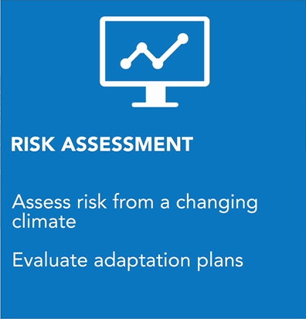

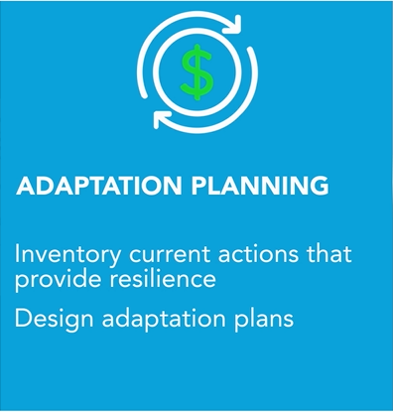
CREAT 3.0 Process
DEMO

Slide 11
Climate Change – Water : Data Services Explore climate change, related hazards and adaptation options at your location

Slide 12
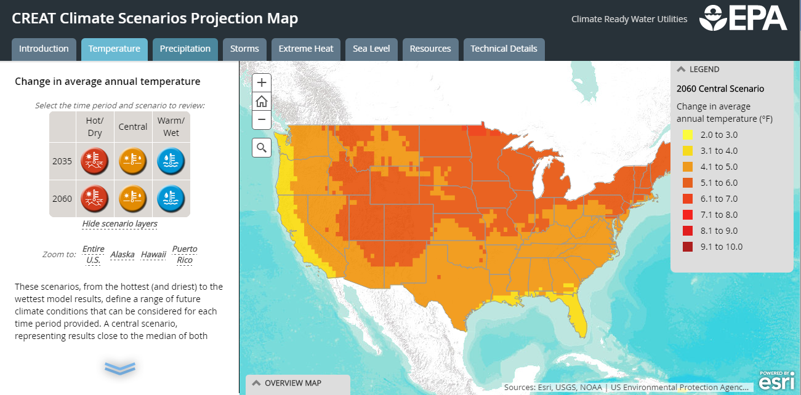
Scenario-Based Climate Change Map
LINK
Provides scenarios that capture the range of projected changes in temperature and precipitation from models

Slide 13
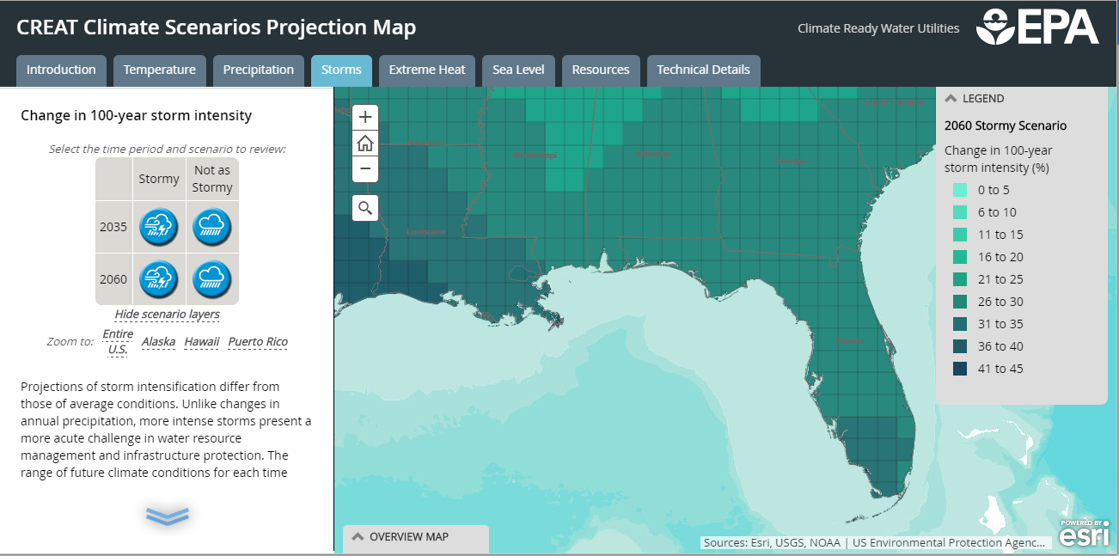
Scenario-Based Climate Change Map
LINK
Data includes changes in average conditions and extreme events (hot days and storms), plus sea level rise

Slide 14
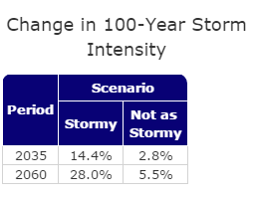
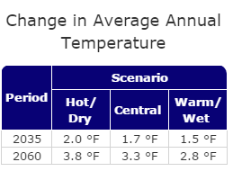
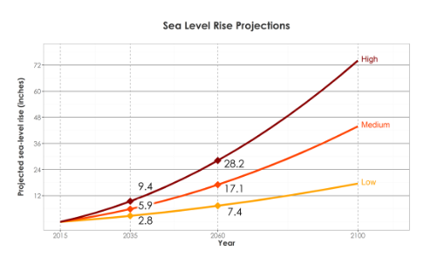
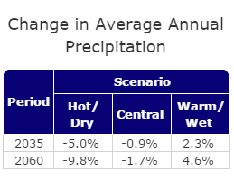
Scenario-Based Climate Change Map
LINK
For the grid cell containing Miami:

Slide 15
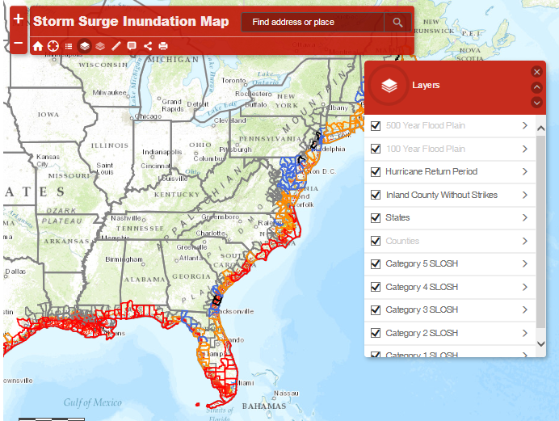
Storm Surge Inundation Map
LINK
Access current worst-case coastal storm surge scenarios and hurricane strike frequency information
Layers include FEMA flood zones and inundation from Sea, Lake, and Overland Surge from Hurricanes (SLOSH) model results
UPDATE IN PROGRESS

Slide 16
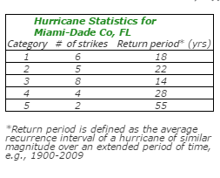
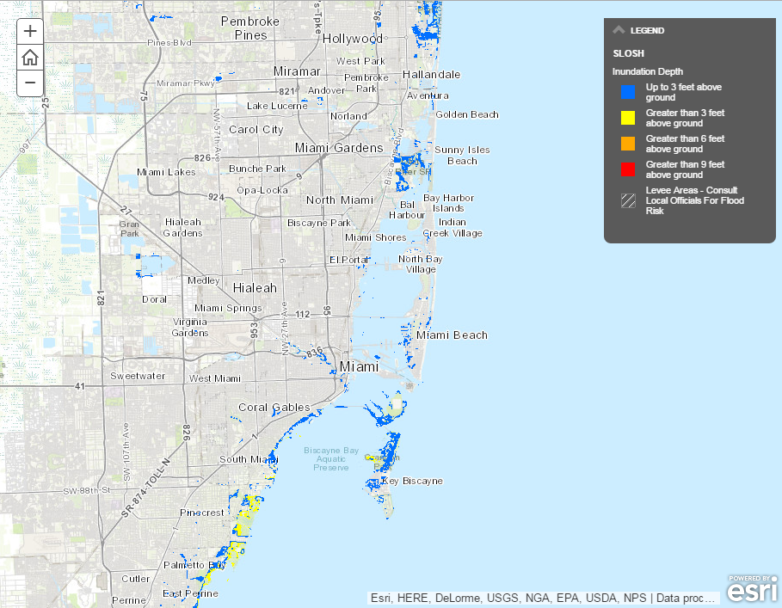
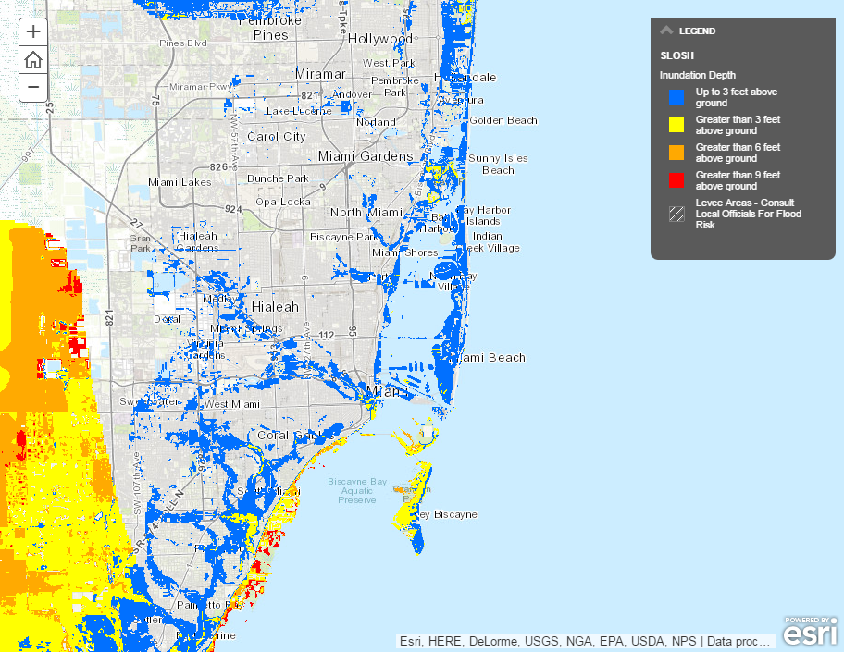
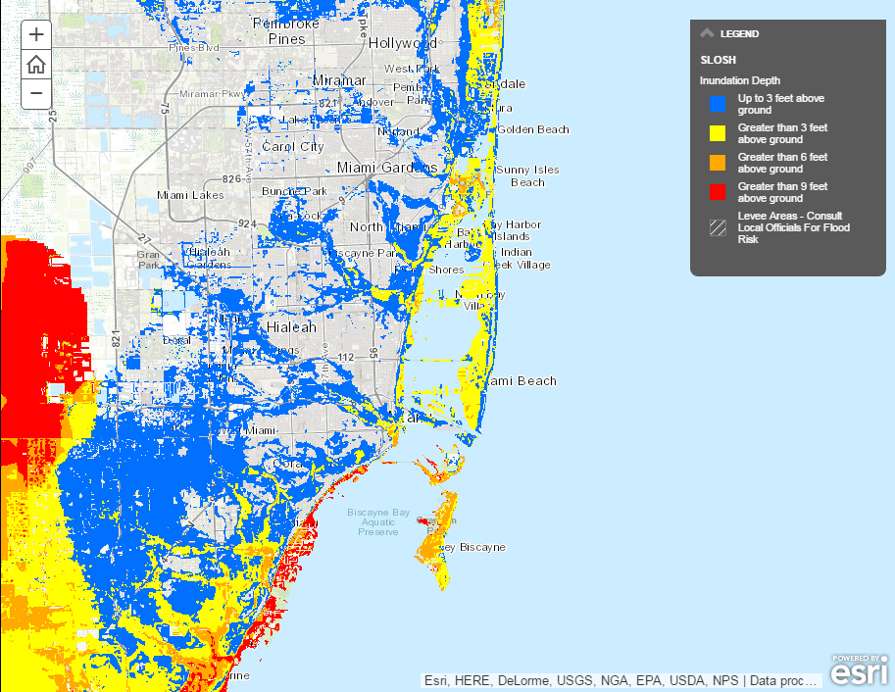
Storm Surge Inundation Map
LINK
For Miami-Dade County:
Frequency of storms and potential flood depth useful for planning
Caution: no consideration of sea level rise or more intense storm events

Slide 17
Pilots and Outreach Activities Join a Community of Climate Ready Water Utilities

Slide 18
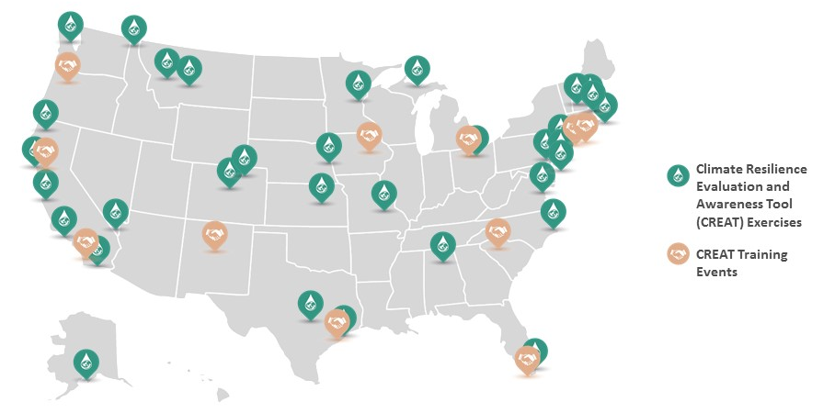
Water Utility Climate Resilience Support Projects

Slide 19
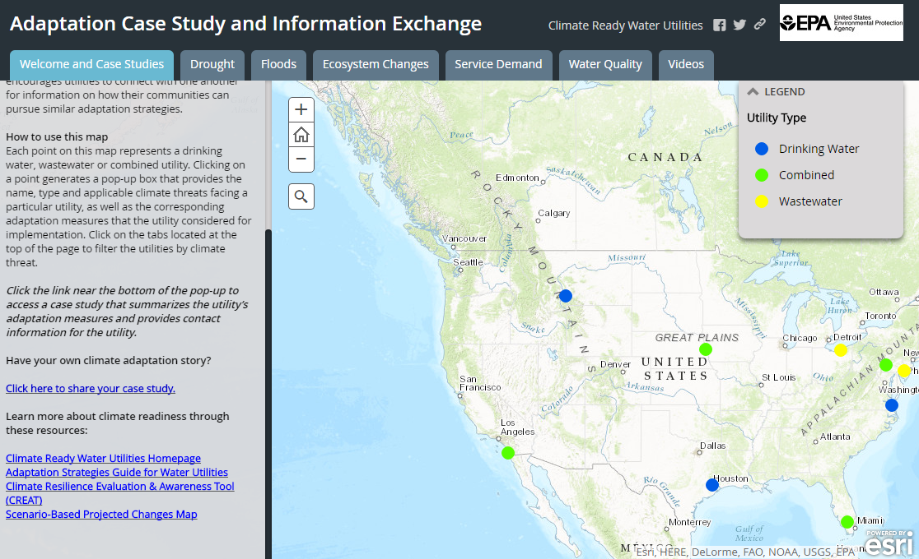
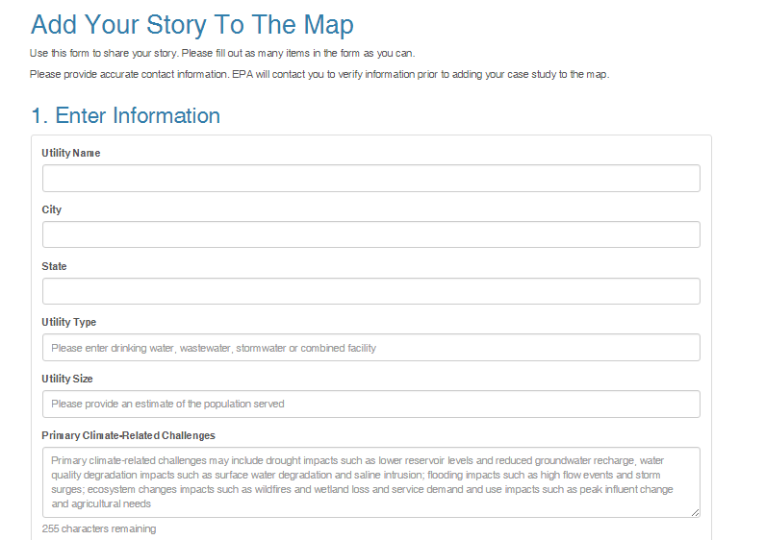
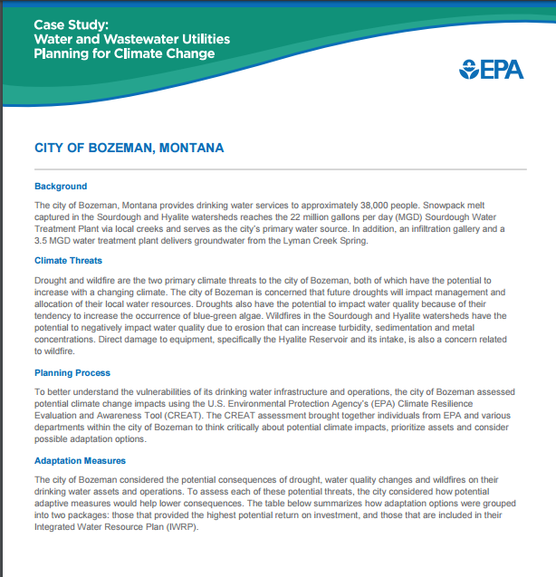
Case Study and Information Exchange
LINK

Slide 20
Notes:
20

Slide 21
Thank you!
Steve Fries
fries.steve@epa.gov
Curt Baranowski
baranowski.curt@epa.gov
Zach Rybarczyk
rybarczyk.zachary@epa.gov
Visit us on the web at: www.epa.gov/crwu
Join our mailing list: crwuhelp@epa.gov

Slide 22
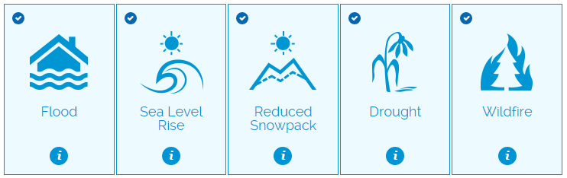
Workshop Planner for Climate Change and Extreme Events
Walks users through all of the steps of planning, conducting and evaluating a workshop
Determine actions that a utility or community can take today to be resilient to several extreme event scenarios
Open lines of communication between utilities and other local partners to assess potential impacts and adaptation to extreme events
DEMO

